Slide 1

Calendar Project Team 9
Elliott, Stan, Haseeb & Katlyn

Slide 2
Calendar Project Introduction
Goal
To create a scheduling platform that utilizes Zoom for meetings. The idea behind this is to create our own version of Calendly.com.
Overview
The website is to be used by at least one Administrator and one User. Registration for both User and Admin will be required for login.
Administrator plays the role of secretary/clerk.
User plays the role of a manager or professor.
Administrator functions – manages User’s daily availability, appointment types and respective time ranges for each appointment type, suggestions of appointments/reoccurring appointments and who attends.
User functions – request administrator to schedule new appointments with the idea of “Please find a time I can meet with so and so”, change scheduling settings, setup/change Zoom account, view/approve/deny appointment requests sent by Administrator and send out Zoom email confirmation.

Slide 3

Objectives
Account login for user and administrator
For the administrator to specify appointment types for different hours
For the administrator to specify days of availability and reoccurring events
For the administrator to be able to specify the time range/time/number of bookings for each appointment type
For the user to have the ability to view the calendar and select days to view appointment availability
To have a grayed out section that the user cannot see for times that are unavailable
For the appointments to be connected to Zoom API for booking time and information
For the user to be able to delete appointments

Slide 4
Technologies Used
JavaScript base language
Node.js JavaScript runtime environment
React JavaScript library installed using Node.js
Replit.com online IDE
Discord for team discussion
Lucidchart
For creating diagrams

Slide 5
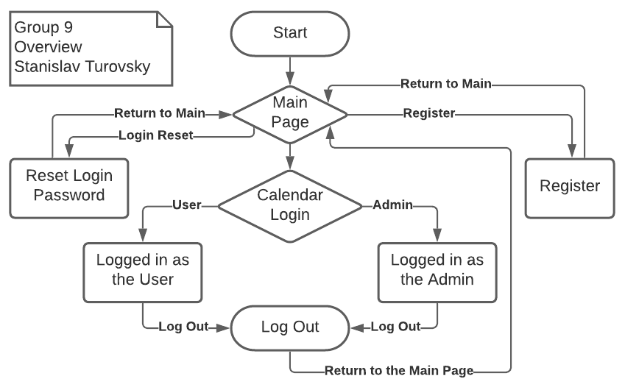
Overview Diagram

Slide 6
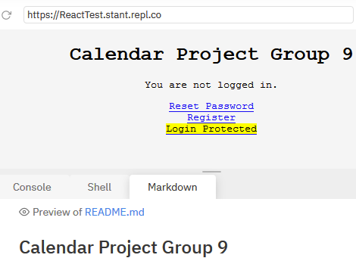
Initial Website Look

Slide 7
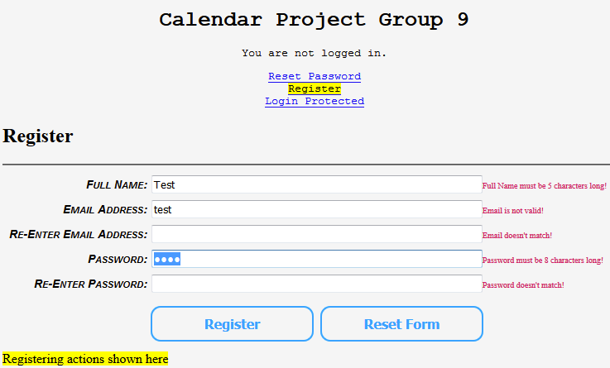
Account Registration Page

Slide 8
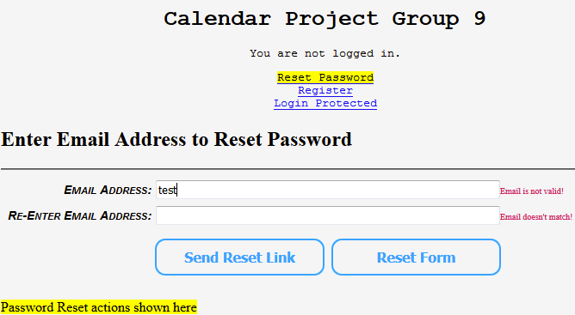
Password Reset Page

Slide 9
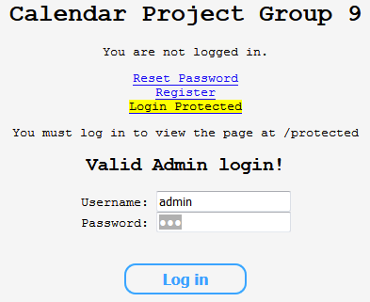
Login Protected Page In Use
Special message shown confirming a valid Administrator login (mostly to speed up testing)
Not shown for a User login

Slide 10
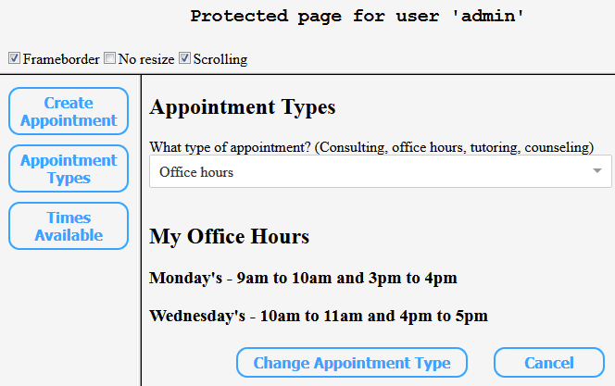
Admin Part Functions Page (Appointment Types)

Slide 11
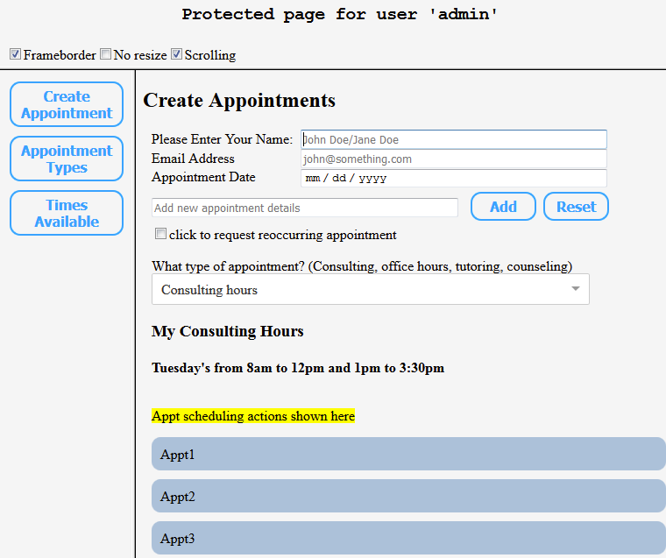
Admin Part Functions Page (Create Appointments)
Initial appearance with an appointment type selected
Oversimpified appointment list (real life version would have actual appointment details)

Slide 12
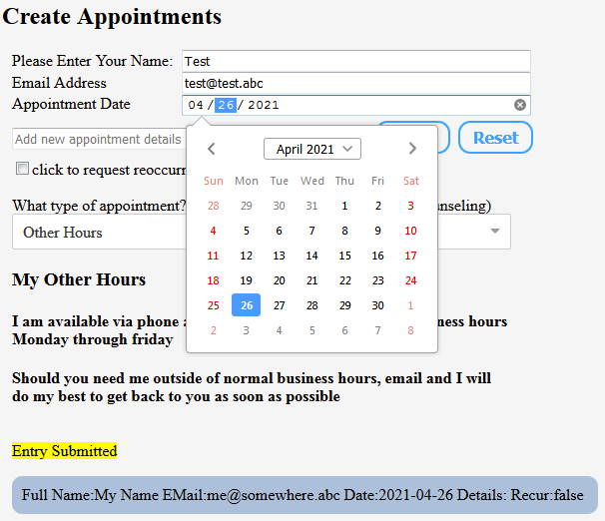
Admin Part Functions Page (Create Appointments)
Appointment created and another is being added
Shows how a built-in calendar pops up to assist with the date entry

Slide 13
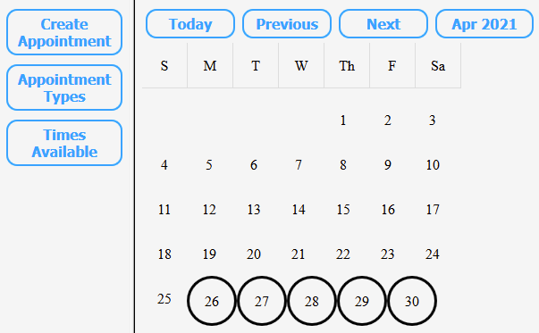
Admin Part Functions Page (Times Available)
Initial look for Times Available
Shows first set of buttons

Slide 14
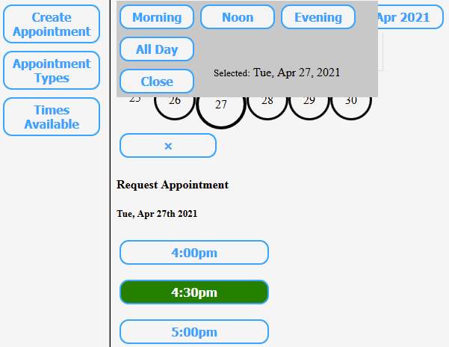
Admin Part Functions Page (Times Available)
Date selected
Available times shown as buttons
4:30pm highlighted on mouse over
Click "x" or "Close" to exit

Slide 15
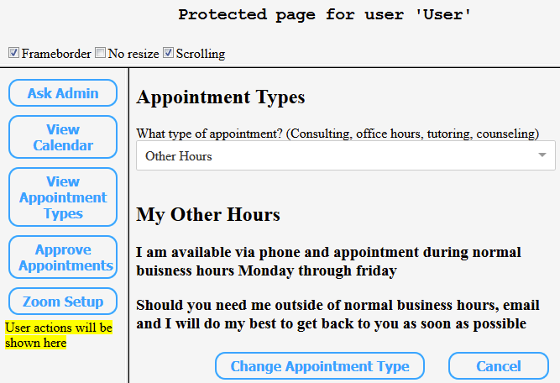
User Part Page
(Appointment Types)
Other Hours selected

Slide 16
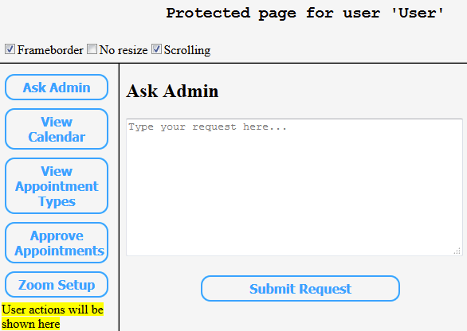
User Part Page
(Ask Admin)
This is where a User can make requests for the Administrator to help with

Slide 17
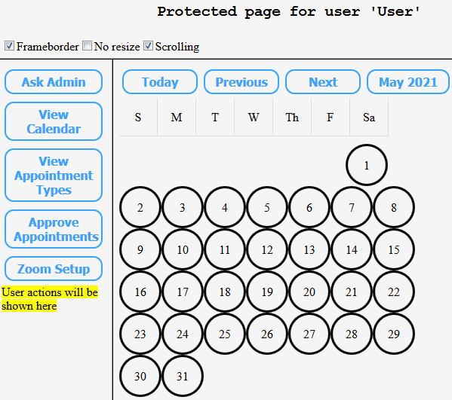
User Part Page
(View Calendar)
User clicked Next
Selected month is the dynamically changing button that says "May 2021" right now
Shows all days as available (circled)
Same mechanism for time selection as for the Administrator

Slide 18
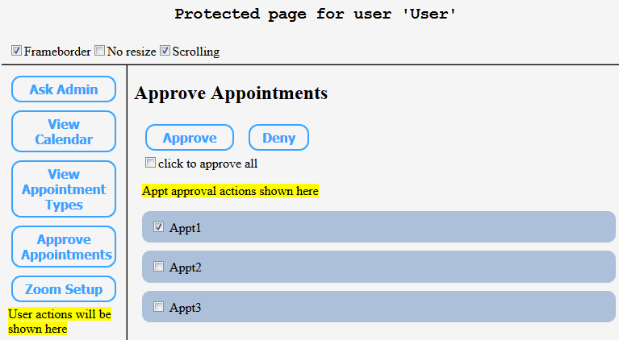
User Part Page
(Approve Appointments)
User clicked Appt1 to select
Can click a single checkmark to approve/deny all
There would be additional details in the list (this is just an example)

Slide 19
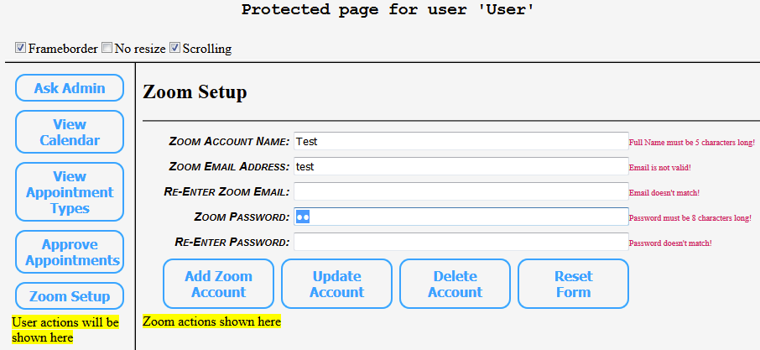
User Part Page
(Zoom Setup)
Add/Update/Delete + form reset buttons
Fields are matched and checked for rules
Not fully implemented due to API complexity – this is just a visual mockup of how we think it should look

Slide 20
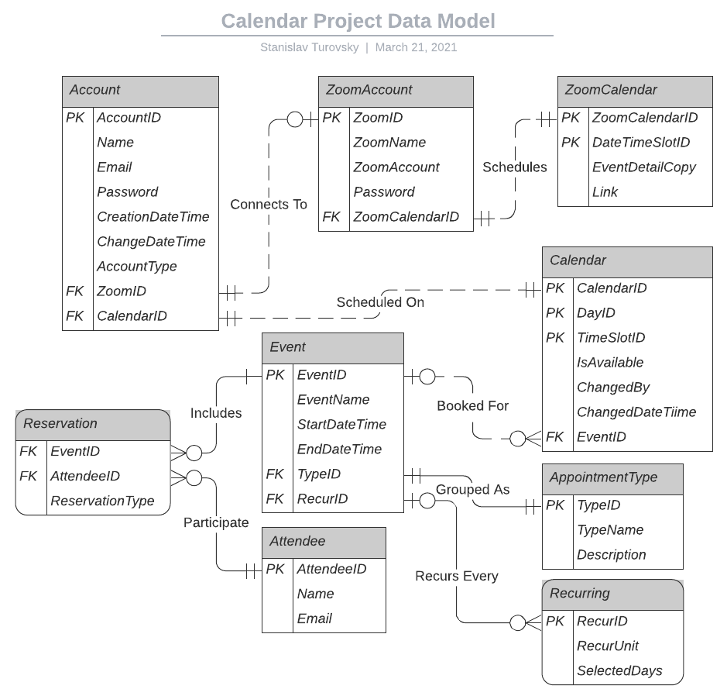

Data Model Diagram

Slide 21
Data Model Description 1of 3
The first entity is Account, that holds website’s Account, and besides its primary key AccountID, it holds account details such as user’s Name, Email, Password, Entry Creation and Change date/times, Account Type (such as User or Administrator), and 2 foreign keys to Zoom Account and Calendar entities.
Zoom Account entity’s, with its self-explanatory name, primary key is ZoomID, and it holds attributes of Zoom’s Name, Account number, Password, and one foreign key to Zoom Calendar entity. There should be none (such as for Administrator) or one (such as for a User) Zoom Account per a website’s Account.
Zoom Calendar entity’s, self-explanatorily named, primary key is merged from ZoomCalendarID and DateTimeSlotID, with Event Detail Copy containing virtually all details later emailed as a confirmation, and Link containing a separate copy of the meeting’s link for quick access purposes. Each Zoom Calendar has exactly one Zoom Account.

Slide 22
Data Model Description 2 of 3
Calendar entity holds the user’s calendar, and its primary key is merged from CalendarID, DayID, and TimeSlotID, with attributes being IsAvailable, ChangedBy, ChangeDateTime, and one foreign key to the Event entity. Calendar can have zero or many Events.
Event entity holds event details, and its primary key is EventID, and it holds attributes EventName, event Start and End date/times, and 2 foreign keys to AppointmentType and Recurring entities. Event can have exactly one appointment type and from zero to many recurrences, as well as from one to many attendee reservations.
Reservation entity is used to combine all possible combinations of events and attendees, and its primary key is merged from foreign keys to Event and Attendee entities. A reservation entry would have exactly one event and one attendee.

Slide 23
Data Model Description 3 of 3
Attendee entity holds all possible attendees, and its primary key is AttendeeID, with attributes of each attendee’s Name and notification Email address. Yes, in theory there could be multiple email addresses, but we are keeping it simple. Each attendee can be linked to from zero or many reservations.
AppointmentType entity holds all possible appointment types, and its primary key is TypeID, with attributes being appointment type’s name (TypeName) and Description. Each appointment type can be used in from zero or many events.
Recurring entity holds event recurrings, its primary key is RecurID, and its attributes are RecurUnit (such as a month or a week) and SelectedDays (such as 2 for “every 2nd day of the month” if the recurring unit is “month”).

